Slide 1

Kaggle – Sales Price of Residential Homes in Ames, Iowa
Kamran Qureshi
Naveen Ithikkat
Rithvik Mundra
Yuebo Li

Slide 2
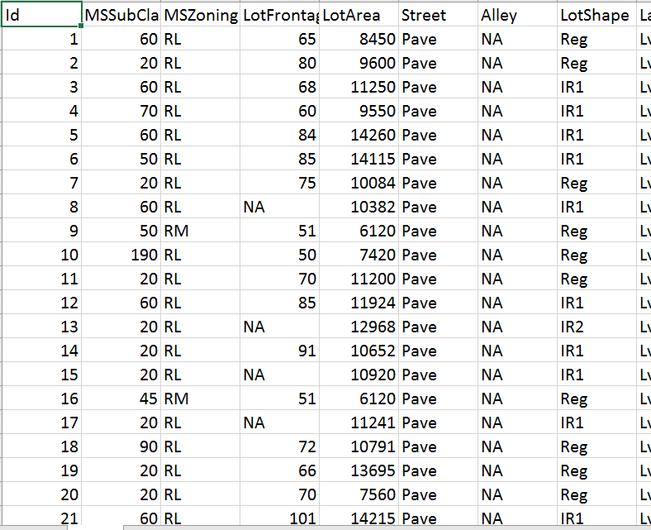


Objective and Data Description
Predict selling prices of residential properties based on data from Ames, Iowa from 2006 to 2010
1460 rows X 81 columns
79 Independent Variables describing various aspects of the properties
37 Numeric Variables including Sales Price – the Target Variable
43 Categorical Variables

Slide 3
Data Preparation
Data Partitioning
Partition of ‘train’ dataset done first into training and validation
Shuffle ‘train’ dataset
Split into 60% for training and 40% for validation
Subsequent data prep steps done separately on training and validation data to avoid ‘data leakage’
60% 40%

Slide 4
Data Preparation
Impute Missing Values
Used Median or Most Frequent value depending on the variable
Variables | Variable Type | No. Missing | Replacement Value
LotFrontage | Numeric | 259 | Median
MasVnrtype | Categorical | 8 | Most frequent
MasVnrArea | Numeric | 8 | Median
Electrical | Categorical | 1 | Most frequent

Slide 5
Data Preparation
Replace Meaningful “NA”s
14 variables have meaningful “NA”s
NA’s replaced so that they are not ignored by the model
Variables | No. “NA”s | Replacement Value
Alley | 1369 | No Alley Access
BsmtQual | 37 | No Basement
BsmtCond | 37 | No Basement
BsmtExposure | 38 | No Basement
BsmtFinType1 | 37 | No Basement
BsmtFinType2 | 38 | No Basement
FireplaceQu | 690 | No Fire Place
Variables | No. “NA”s | Replacement Value
GarageType | 81 | No Garage
GarageYrBlt | 81 | No Garage
GarageFinish | 81 | No Garage
GarageQual | 81 | No Garage
GarageCond | 81 | No Garage
PoolQC | 1453 | No Pool
Fence | 1179 | No Fence

Slide 6
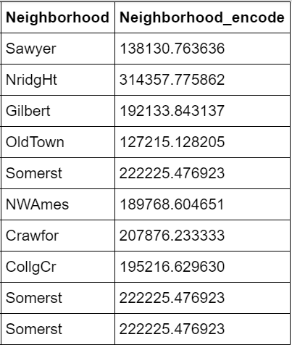
Data Preparation
Average-by-level
Converted categorical data to numerical data using average by level technique as XGBoost cannot handle categorical data .

Slide 7
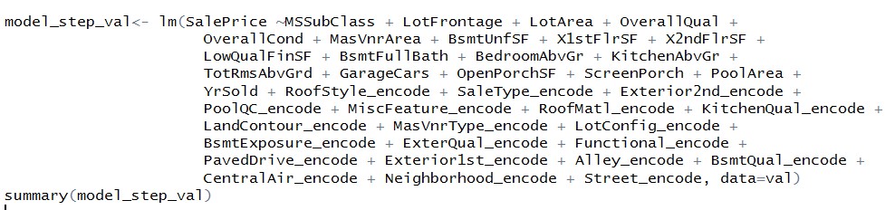
Stepwise Regression Model (R)
Variables Chosen by the Model

Slide 8

Stepwise Regression Model (R)
Training:
Root Mean Squared Error: 27640
R-Square: 0.8789
Validation:
Root Mean Squared Error: 29590
R-Square: 0.8636

Slide 9
Elastic Net (Python)
Parameters Tuning
alpha = 0.5
Controls the magnitude of penalty
l1_ratio = 0.5
Tunes balance between L1 and L2 penalties
max_iter = 3000
Maximum number of Iterations

Slide 10
Elastic Net Model
Training:
Root Mean Squared Error: 23234.6536
R-Squared: 0.8971
Validation:
Root Mean Squared Error: 27315.3123
R-Squared: 0.8796

Slide 11

XG Boosting Model (Python)
Parameters Tuning
max_depth = 3
Used to control overfitting as higher depth will allow model to learn relations very specific to a particular sample
n_estimators = 300
Number of boosting stages to perform
learning-rate = 0.05
How fast the model converges
Colsample rate= 0.2
reg_alpha = 0.5

Slide 12
XG Boosting Model (Python)
Results
Training
Root Mean Squared Error: 15167.106
R-Squared: 0.9634
Validation
Root Mean Squared Error: 24477.1839
R-Squared: 0.9065

Slide 13

Model Comparison
Model | R2 Value -Training | R2 Value -Validation
Stepwise | 0.8789 | 0.8636
Elastic Net | 0.8971 | 0.8796
XGBoost | 0.9634 | 0.9065

Slide 14


